Slide 1
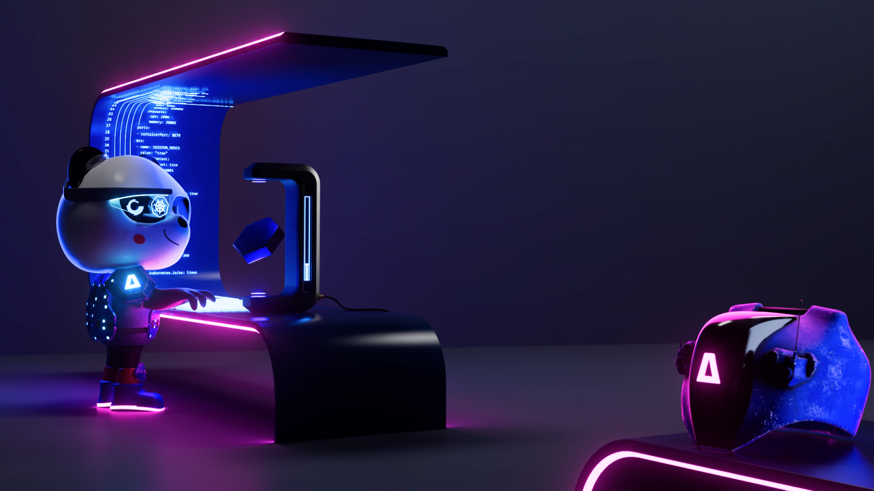
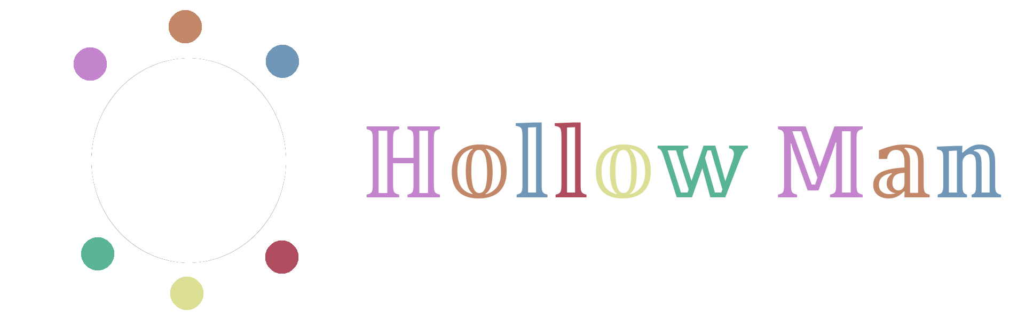
Fully Automated Release and Code Review with CI/CD Case Study from Kubescape
Songlin Jiang hollowman@opensuse.org
Notes:
Hi everyone, welcome to this talk! Today, I’ll show you how we achieve fully automated release and code review with CI/CD at Kubescape, an LFX mentorship project during twenty twenty-three spring term.

Slide 2
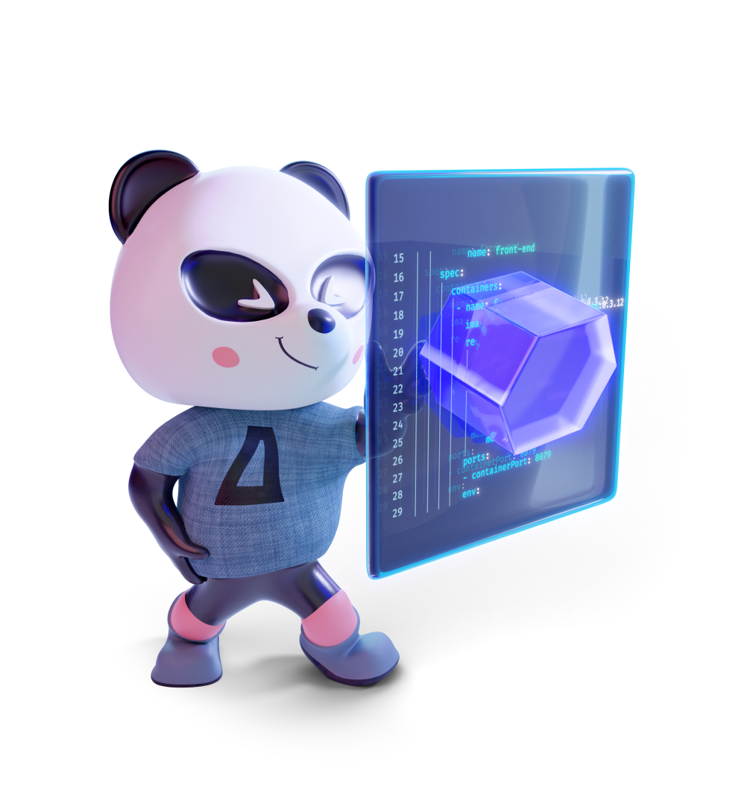


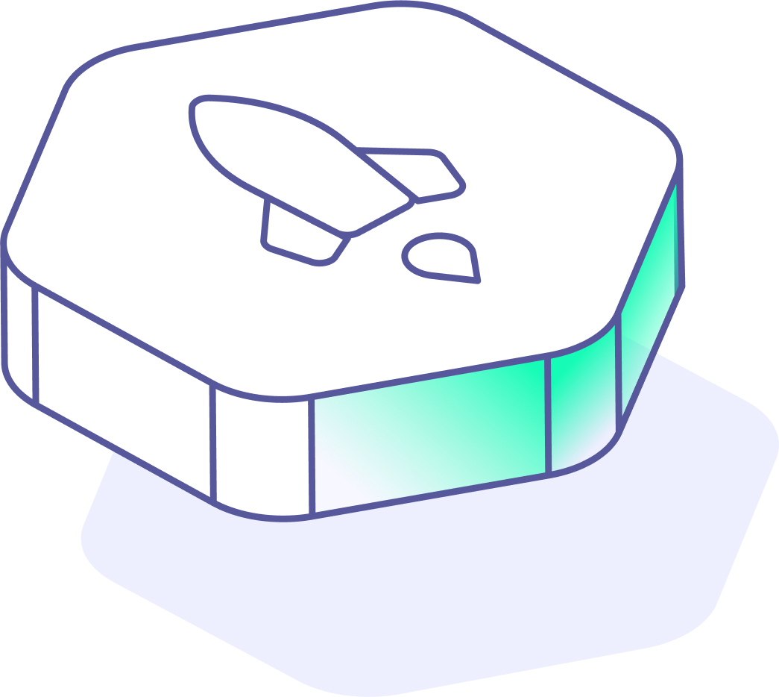




/WhoAmI_
Doctoral Researcher
Aalto University
SECCLO Alumni
Free Software Advocate
Mentee
LFX Mentorship 2023 Spring Term
Kubescape Contributor
@HollowMan6
@songlin-jiang
@HollowM186
Notes:
First, let me give a brief self-introduction. I’m Songlin Jiang, and I'm currently a doctoral researcher at Aalto University in Finland working on machine learning systems and databases. I’m also an alumnus of SECCLO, which is an Erasmus Mundus master’s program in security and cloud computing. Additionally, I am a passionate free software advocate. During my leisure time, I maintain several open-source projects and contribute to many others. At Kubescape community, I was once a mentee of the LFX Mentorship and also a contributor. I refer to myself as Hollow Man on the internet. If you are interested, you can find me on GitHub, Linkedin, and X.

Slide 3

Release Engineering
Notes:
Now, we are going to talk about the second part, which is an introduction to the release engineering I helped with at Kubescape.

Slide 4

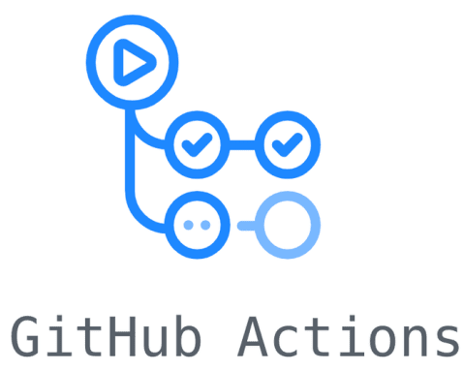
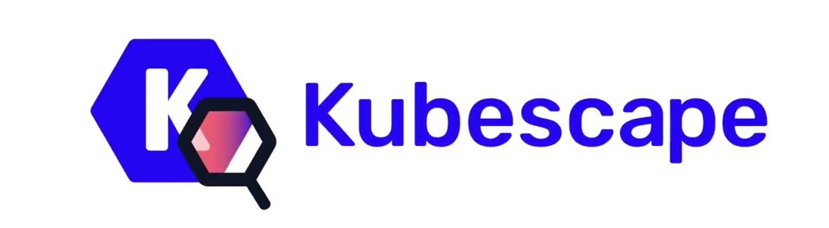
/Achievements_
CI/CD integration with Release
Involves building, testing, and packaging software & components
Push Tags
Reduces manual intervention, minimizing human error
Enables frequent releases, faster feedback, and time-to-market
Cross-building for multi-platforms
Triggers
Release
Available for common package managers
Notes:
We integrated the release process into the CI/CD that Kubescape uses, which is GitHub Actions. Whenever the maintainers decide to push a git version tag to the git repository, the GitHub Actions are triggered, and then we can have a new release of Kubescape. The release process at Kubescape involves building, testing, and packaging software and components. As Kubescape is a Golang program with C binding, we also want to support cross-compilation so that we can build for multiple platforms on multiple architectures. We also made Kubescape available for common package managers and enabled bumping those versions in the packaging scripts automatically. In this way, users can receive new releases without any manual upgrades. My contributions helped reduce manual intervention and minimize human error, which enables frequent releases, as well as faster feedback and time to market.

Slide 5
Automatic GitHub Code Review
Notes:
Now, let’s discuss the last part of this talk, which is to show you how we make Kubescape capable of automatically performing GitHub code reviews.

Slide 6
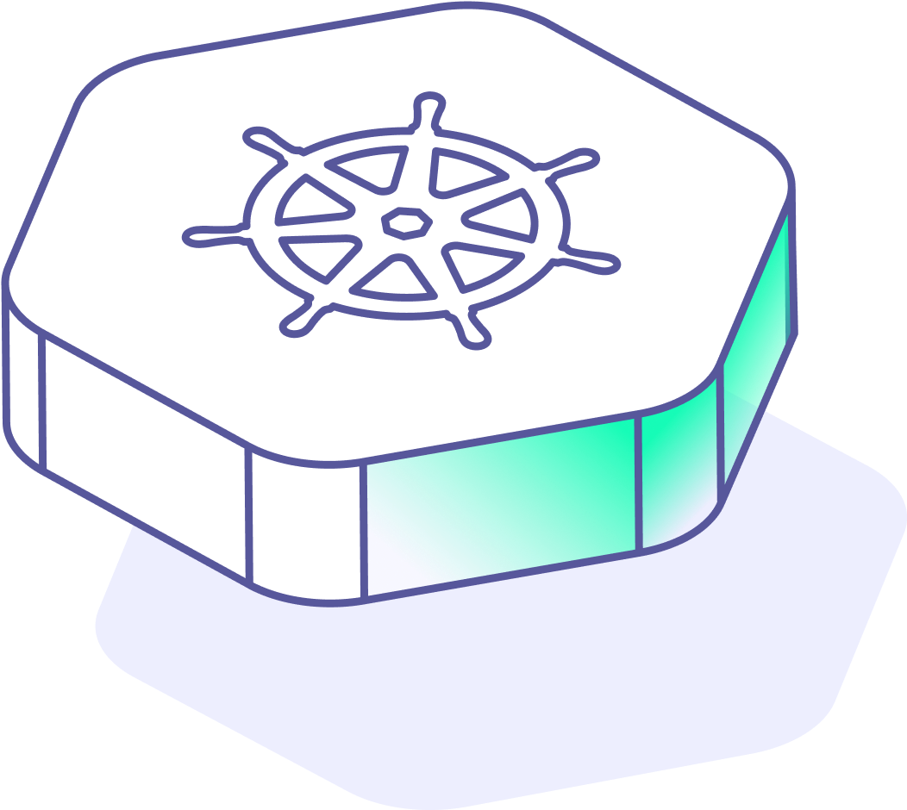


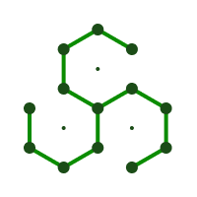

/Workflow
triggers
Runs
Comments
Generates
Runs
Uploads
GitHub Security
HollowMan6/
sarif4reviewdog
Converts to Reviewdog Diagnostic Format
Inputs
Static Analysis Results Interchange Format (SARIF)
Notes:
First, let’s take a look at the workflow for the process. When the developer newly opens or pushes code to a pull request or a repository on GitHub, a pre-defined GitHub Actions workflow will be triggered to run the Kubescape. The Kubescape will run a scan on the code files in search of misconfigurations and generate the report in the static analysis results interchange format. The files can be uploaded to GitHub Security if the developper pushed to the main branch directly so that maintainers can be alerted for possible vulnerabilities. Or, if it’s a pull request, the file will be forwarded to the review dog using the converter so that it can be converted into the review dog diagnostic format. The reviewdog then is in charge of generating reviews for code fix suggestions by commenting with a new review. To support those fix suggestions, I helped add the “fix” object support for the Kubescape-generated SARIF report.

Slide 7
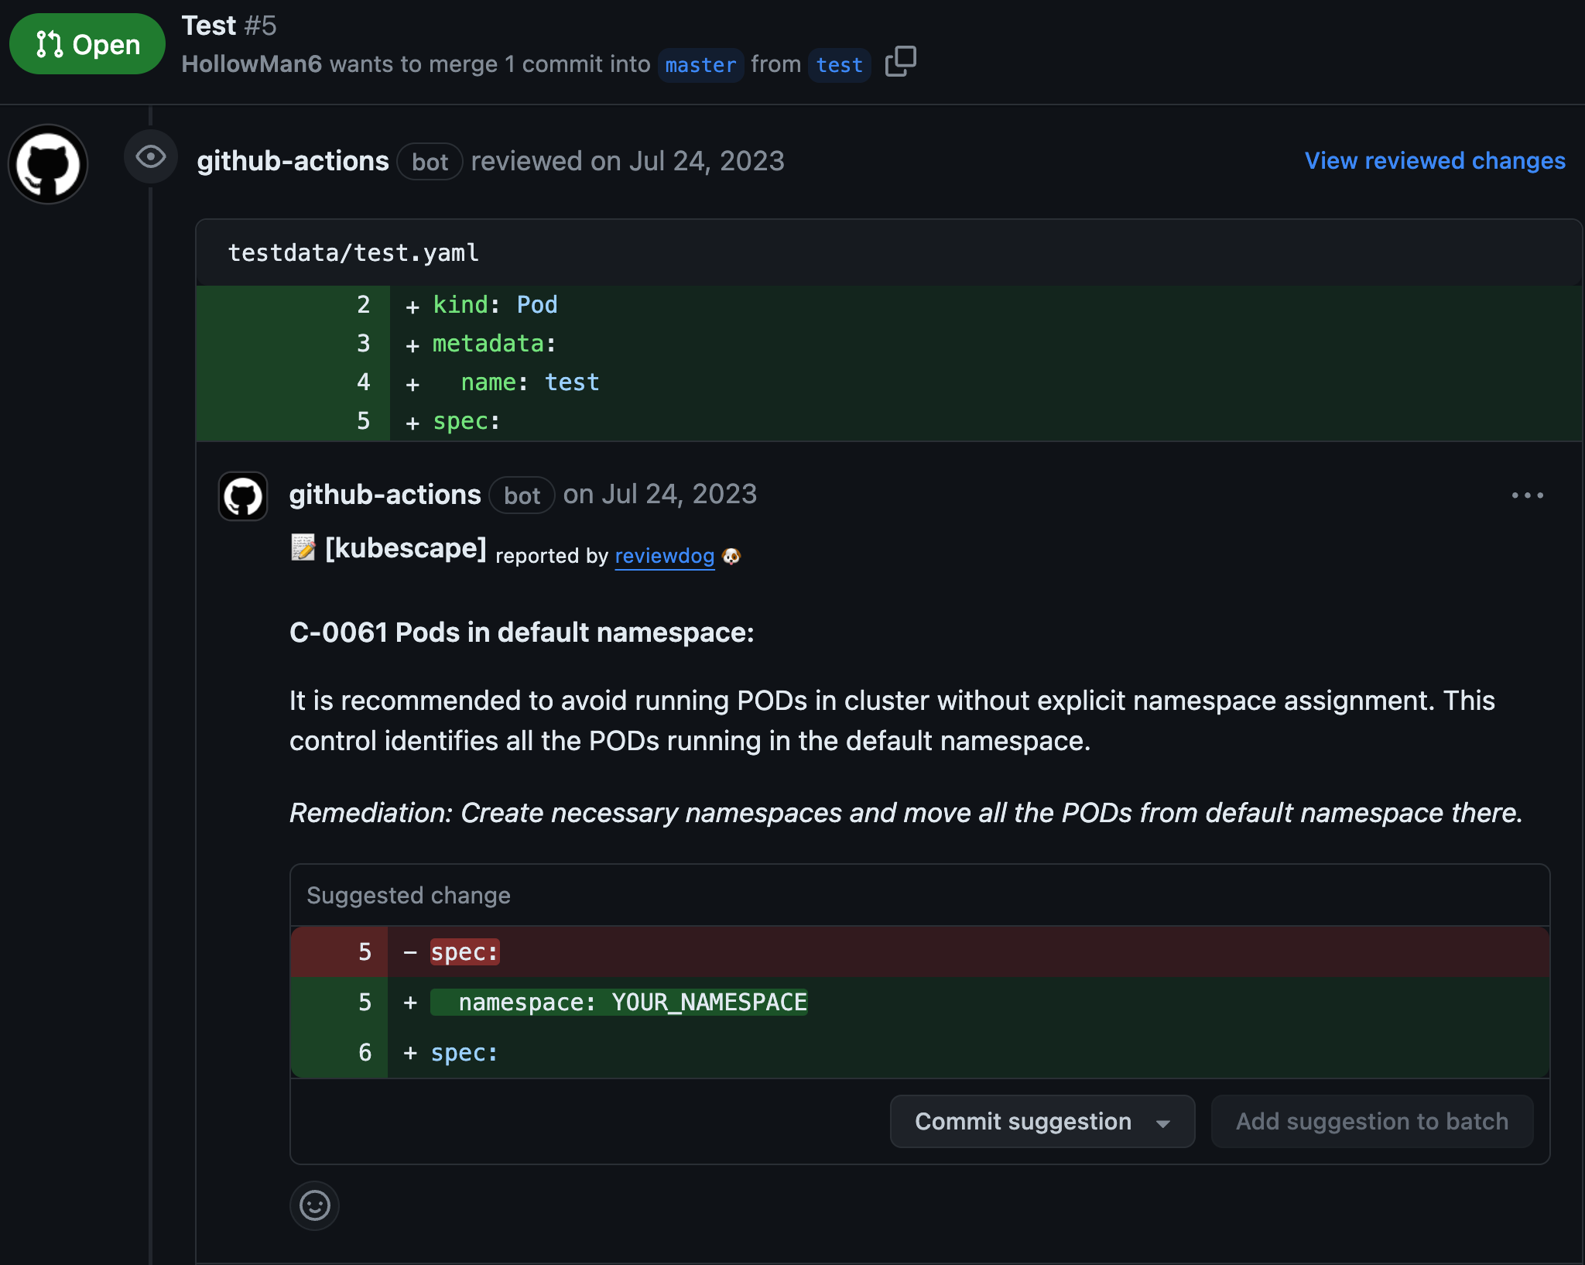

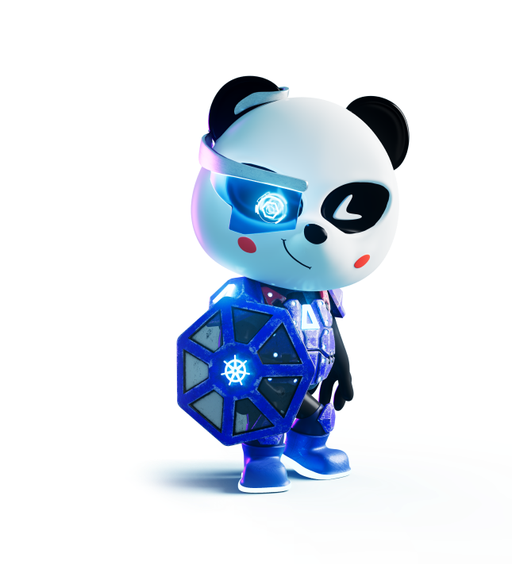
Demo
Notes:
Here is a demo showing what it looks like for the automated GitHub code reviews. Users can apply fixes generated from Kubescape directly by clicking the commit suggestion button.

Slide 8
/Conclusion_
7 Repositories & Packages
34 Pull Requests
21 issues
Notes:
That’s all about my main contributions. Aside from these, I was also involved in other issues and had a highly productive and fulfilling experience working on the Kubescape project. The mentorship program allowed me to make substantial contributions to the Kubescape project and collaborate effectively with my mentor and the community, enhancing my skills and knowledge in the process. I’m proud that I could have such kind of an experience!

Slide 9
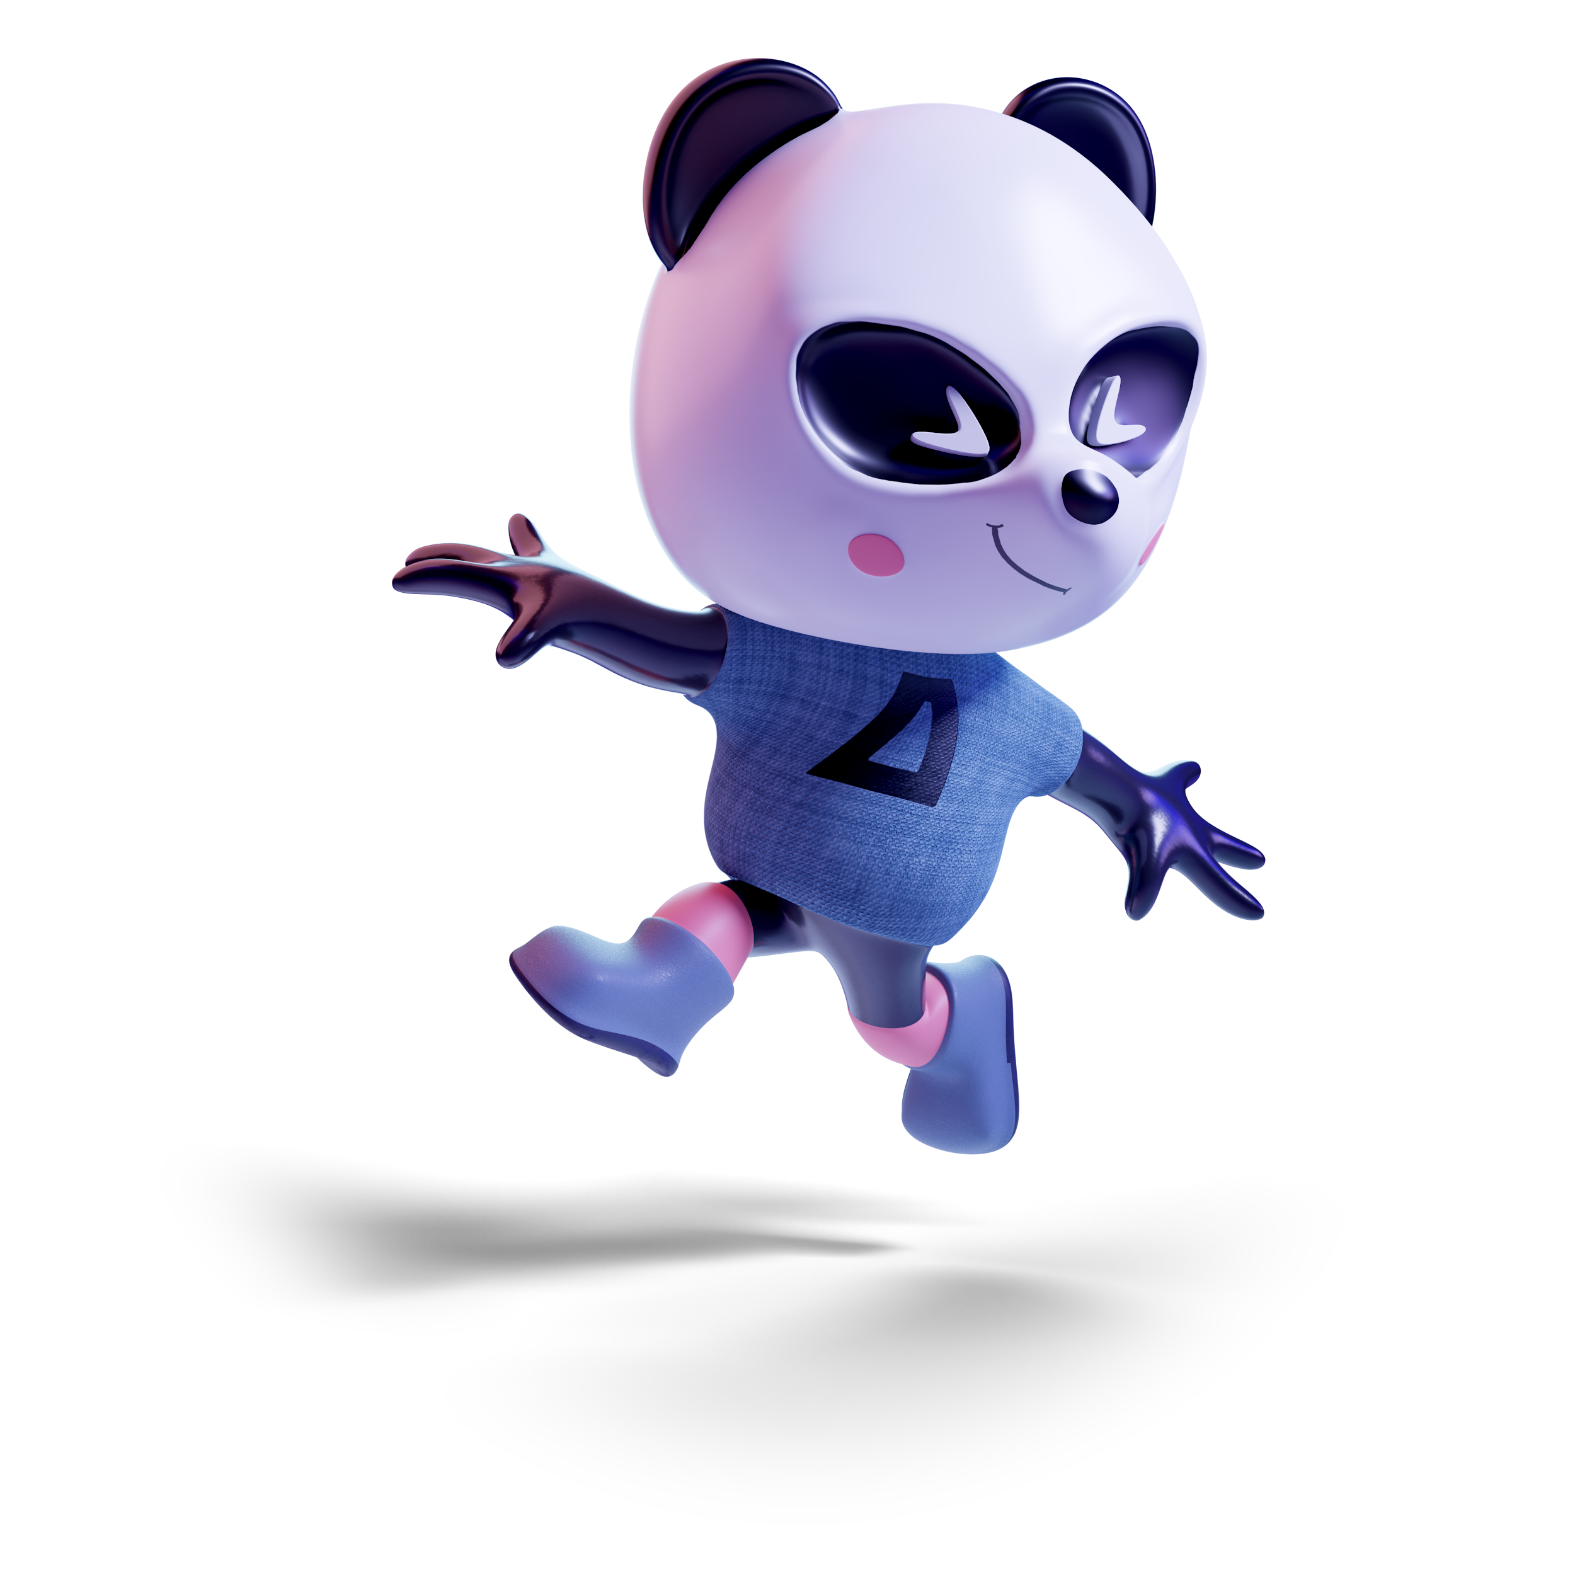


@HollowMan6
@songlin-jiang
@HollowM186
Thank you_
Notes:
Thanks again for coming and listening to this talk! Now, I’m researching machine learning systems and databases, if you are also interested in Large Language Models training and inference or Vector and Graph Databases for Retrieval-Augmented Generation systems, let’s connect!

